Slide 1
Kansas Disability Employment Survey Results
Employment Systems Change (ESC) Coalition membership:
Skills to Succeed, the University of Kansas Research and Training Center on Independent Living (RTC/IL), National Alliance on Mental Illness (NAMI), Self Advocate Coalition of Kansas (SACK), Kansas Association of Centers for Independent Living (KACIL), Interhab (represented through Interhab member OCCK), Disability Rights Center of Kansas, the Association of Community Mental Health Centers of Kansas, and the Autism Society – The Heartland.
The ESC Coalition was funded through a generous grant by United Healthcare, Empower Kansans grant
Survey was conducted from December 2015 to March 2017.
Nearly 1,700 Kansans took the survey (1,628).
Questions were tailored to the individual’s life-experiences (ex: a transition aged student in Special Education or their families were asked about SPED and transition, etc.). Major types of people surveyed included:
  Individuals with disabilities
  Family members of individuals with disabilities
  Guardians or Educational Advocates of individuals with disabilities
  Disability Service Provider Employees
  State Employees

Slide 2







Survey Reach Demographics (1,682 completed survey)
8%
Breakdown of Respondents:
29%
26%
134
480
29% - Individuals with Disabilities
31% - Parent/Family Member of an Individual with a Disability
5% - Legal Guardian of an Individual with a Disability 1% - Educational Advocate for a Student with an IEP 26% - Employees of a Disability Service Provider 8% - State Employee
442
17
5%
89
520
1%
31%
29% - Intellectual/Developmental Disability (I/DD) 21% - Autism
19% - Physical Disability 2% - Blind/Visually Impaired 5% - Deaf/Hard of Hearing 5% - Brain Injury
20% - Behavioral/Mental Health Issue
20%
29%
195
275
5%
45
43
5% 17
2%
180
200
19%
21%

Slide 3

Survey Demographics
Survey Participants KS Census
Hispanic or Latino
Black (African-American) American Indian, Native American or Alaskan Native
Asian Hawaiian Caucasian
Preferred not to Answer Responded Other or I don’t know
 | 5.4% |  | 5%
 |  | 10.
 |  | 9%
 | 5.9%
2.7% 1%
2.5% 2.4%
0.1% 0.1%
 |  |  |  |  |  |  | 82.2% 83.3%
 | 4%
2%
Rural 30.3%
Urban 38.4%
Suburban 31.3%
0%
20%
40%
60%
80%
100%
250
31.2%
Age of Respondents:
200
20.6%
150
9.9%
6.5% 4.1%
100
14.7%
8.5%
4.4%
50
0
0-13
14-21 (Transition Age)
22-24
25-34
35-44
45-54
55-64
65 & Older

Slide 4
Social Security Benefit Myths
Percentage who answered correctly the amount of money a Kansan with a disability can earn and still receive at least some part of their SSI disability check:
Individual with a Disability
100%
95.8%
75%
50%
25%
4.2%
0%
Correct Answer
$1,551
Incorrect Answer
$0, $85, $837,
I don’t know

Slide 5


Social Security Benefit Myths
Percentage of SSI recipients who wrongly believe they will “never come out ahead by working” because “for every $1 I earn, my SSI disability check will be reduced by $1” or they believe they will lose their entire check if they work at all.
Both of these concepts are completely false.
Individual with a Disability
49% say they will never come out ahead if working 51% say they will lose SSI if working
80%
 | 76.4%
60%
40%
51%
49%
20%
0%
Incorrect Response

Slide 6
Where do you reside?
Individual with a Disability
2% - Institution (nursing facility, DD state hospital, etc.)
9% - Group Home or Residential Care Home with several people 26% - With Family
63% - Independently (may or may not include with friends and/or supports)
2%
9%
26%
63%

Slide 7
Of those who currently do NOT live independently, a clear majority WANT to live independently.
Respondents were asked do you want to live independently?
Individual with a Disability
Yes (61%) No (28%) Not Sure (11%)
11%
28%
61%

Slide 8
Are you currently working?
Individual with a Disability
100%
75%
64.6%
50%
35.4%
25%
0%
Yes
No

Slide 9
How many jobs does the Kansan with a disability have?
Disability Community
(persons with disabilities, parents/family members, guardians, educational advocates)
100%
84.2%
75%
50%
25%
15.1%
0%
0.7%
1
2
3 or more

Slide 10
What would most help the Kansan with a disability become employed in a competitive and integrated job?
(Respondents could only choose their top three.)
Disability Community
(persons with disabilities, parents/family members, guardians, educational advocates)
On-going support to keep the job
15.9%
Other
14.8%
Supports at the Workplace
Help finding a job
14%
3.3%
3.4%
11.7%
Learning more about work
Having an opportunity to visit a job site
Talking with someone who is working
2.3%
Trying out a job
9%
Finding out what kind of job I would like to have
7.9%
Someone to help me learn how to do the job
9.5%
Skills training to better perform the basic expectations of jobs, like keeping a schedule
8.2%
0%
12.5%
25%

Slide 11


How many hours a week does the Kansan with a disability work?
Disability Community
(persons with disabilities, parents/family members, guardians, educational advocates)
50%
40%
30%
24.3%
22.9%
19.9%
21.6%
20%
11.3%
10%
0%
<10
10-19
20-29
30-39
40+

Slide 12

Who has been the most helpful person in helping the Kansan with a disability in their search for employment?
Disability Community
(persons with disabilities, parents/family members, guardians, educational advocates)
2% - Teacher 7% - Rehabilitation counselor (Vocational Rehabilitation) 14% - Job coach / employment specialist | 2%
6% - Service provider employee
14% - Case manager | 29%
29% - Friends and family
29% - Other (please specify the type of help received)
7%
14%
6%
14%
29%

Slide 13
Employment First
Before reading about it just now, did you previously know about the specific requirements of the 2011 Employment First Law?
All Respondents
100%
75%
65.4%
50%
28.3%
25%
6.2%
0%
Yes
No
I don’t know

Slide 14
Breakout by Respondent:
Before reading about it just now, did you previously know about the specific requirements of the 2011 Employment First Law?
Disability Community
(persons with disabilities, parents/family members, guardians, educational advocates)
Individual with a Disability Employee of a Disability Service Provider State Employee
100%
75%
74%
75.5%
64.4%
52.3%
50%
44.1%
31.8%
25%
18.3%
14.8%
9.7%
0.7%
3.6%
3.8%
0%
Yes
No
I don’t know

Slide 15
Do you know about the specific rights granted to children and youth under 21 contained in the federal Medicaid Act called EPSDT (Early Periodic Screening Diagnostic and Treatment)? In Kansas the EPSDT program is called KanBe Healthy.
All Respondents
100%
75%
56.5%
50%
36.6%
25%
6.8%
0%
Yes
No
I don’t know

Slide 16
Breakout by Respondent:
Do you know about the specific rights granted to children and youth under 21 contained in the federal Medicaid Act called EPSDT (Early Periodic Screening Diagnostic and Treatment)? In Kansas the EPSDT program is called KanBe Healthy.
Disability Community
(persons with disabilities, parents/family members, guardians, educational advocates)
Individual with a Disability
Employee of a Disability Service Provider
State Employee
100%
75%
59.9%
63.4%
57.5%
50%
46.9%
47.2%
33.2%
36.6%
27.9%
25%
_{6.9%} 8.6% _{5.9%}
6%
0%
Yes
No
I don’t know

Slide 17







Of the 15% who reported they were working with Vocational Rehabilitation (VR), this is how they rated their experience with VR.
Individual with a Disability
Individual with a Disability
50.0%
50%
42.3%
40.0%
33.3%
40%
37.8%
30.0%
30%
19.7%
21.2%
20.0%
15.2%
20%
10.0%
4.5%
6.1%
10%
0.0%
Great
Good
OK
Not Good
Bad
Not Sure
0%
“Positive” VR Experience (Great & Good)
“Negative”
VR Experience (Not Good & Bad)
Great & Good = 42.3% Not Good & Bad = 37.8%

Slide 18
Why Aren’t You Working with VR?
Of those Individuals with Disabilities who are NOT working with VR, they were asked: “Why are you not currently working with VR?”
Their responses were:
11%
13%
13% - I worked with VR before, but was not satisfied with the services 49% - I don’t currently need VR services
27% - I don’t know about VR services
11% - I tried to apply for VR services, but was unsuccessful
27%
49%

Slide 19
Unsuccessful with VR
Of those who said they were unsuccessful in applying for VR services, they were asked: “Why were you unsuccessful in applying for VR services?”
Their responses were:
21%
26%
26% - I was told I was not eligible for VR
44% - I never got a call back from VR, or if I did it was too late 9% - The wait for VR services was too long
21% - Other
9%
44%

Slide 20
Why Don’t You Need VR?
Of those who said they do not need VR services, here is how they answered the question: “Why do you not need VR services?”
Individual with a Disability
37% - I already have a job that pays at least the minimum wage where my co-workers are mostly people without disabilities 64% - I do not want to pursue employment
37%
64%

Slide 21
VR and Students with Disabilities
Has the student with a disability received a letter from Vocational Rehabilitation (VR) explaining the services they can provide? VR is a program housed in the Department for Children and Families.
Disability Community
(students with IEPs, parents/family members, guardians, educational advocates)
100%
75%
69.7%
50%
25%
21.2%
9.1%
0%
Yes
No
I don’t know

Slide 22
VR and Students with Disabilities
Respondents who are transition-age (students with IEPs, parents/family members, guardians, educational advocates) answered the following: “Do you know about the services Vocational Rehabilitation (VR) provides?”
Disability Community (students with IEPs,
parents/family members, guardians, educational advocates)
Student with a Disability Parent/Guardian/Education Advocate
60%
56.8%
57.3%
53.8%
45%
42.3%
30%
29.4%
25.4%
17.8%
15%
13.3%
3.8%
0%
Yes
No
I don’t know

Slide 23
VR and Students with Disabilities
Has the student with a disability received a referral to Vocational Rehabilitation (VR) from his/her school?
Disability Community
(students with IEPs, parents/family members, guardians, educational advocates)
Yes
17.6%
No
60.8%
I don’t know
21.6%
0%
17.5%
35%
52.5%
70%

Slide 24
VR and Students with Disabilities
Does the student with a disability know about the Vocational Rehabilitation (VR) program and what it can do to help get a job and reach IEP transition goals?
Disability Community
(students with IEPs, parents/ family members, guardians, educational advocates)
Student with a Disability
90%
85.7%
67.5%
56.8%
45%
25%
22.5%
18.2%
14.3%
0%
0%
Yes
No
I don’t know

Slide 25
VR and Students with Disabilities
Does the student with a disability know how to access Vocational Rehabilitation (VR) services?
Parent/Guardian/Educational Advocate
Student with a Disability
Yes
0%
12.8%
74.4%
No
66.7%
12.8%
I don’t know
33.3%
0%
20%
40%
60%
80%

Slide 26
VR and Students with Disabilities
Does the student with a disability have a Vocational Rehabilitation (VR) counselor assigned to them?
Disability Community
(students with IEPs, parents/family members, guardians, educational advocates)
70%
61.4%
52.5%
35%
32.7%
17.5%
5.9%
0%
Yes
No
I don’t know

Slide 27
VR and Students with Disabilities
Seniors in high school with an IEP were asked: “Do you have a signed Individualized Plan for Employment with Vocational Rehabilitation (VR)?” These are their responses:
Student with a Disability
Yes
0%
No
66.7%
I don’t know
33.3%
0%
17.5%
35%
52.5%
70%

Slide 28
Transition
Has the student with a disability’s IEP Team explained to him/her what a transition plan is and what services are available as transition services?
Disability Community
(students with IEPs, parents/family members, guardians, educational advocates)
100%
75%
50%
50%
31.8%
25%
18.2%
0%
Yes
No
I don’t know

Slide 29
Transition
Has the student with a disability been invited to the IEP meeting to discuss transition planning?
Disability Community
(students with IEPs, parents/family members, guardians, educational advocates)
50%
41.8%
38.8%
37.5%
25%
19.4%
12.5%
0%
Yes
No
I don’t know

Slide 30
Transition
Has the IEP team explained transition services the student with a disability needs to prepare for adult life?
Disability Community
(students with IEPs, parents/family members, guardians, educational advocates)
100%
75%
50%
49.3%
40.3%
25%
10.4%
0%
Yes
No
I don’t know

Slide 31
Transition
Does the student with a disability’s IEP contain a written transition plan?
Disability Community
(students with IEPs, parents/ family members, guardians, educational advocates)
Student with a Disability
Parent, Guardian, Educational Advocate
100%
75%
67.6%
53.8%
55%
50%
40%
25%
26.4%
22.5%
19.8%
5%
9.9%
0%
Yes
No
I don’t know

Slide 32
Transition
Has the IEP team helped write in the IEP what the student with a disability wants to do after high school?
Disability Community (students with IEPs,
parents/family members, guardians, educational advocates)
Student with a Disability
Parent, Guardian, Educational Advocate
48%
Yes
4.2%
61.5%
41.2%
No
87.5%
26.9%
10.8%
I don’t know
8.3%
11.5%
0%
25%
50%
75%
100%

Slide 33
Transition
Does the student with a disability know what they want to do after high school?
Student with a Disability
Parent, Guardian, Educational Advocate
100%
75%
57.7%
50%
50%
41.7%
28.2%
25%
8.3%
0%
14.1%
Yes
No
I don’t know

Slide 34
Transition
Through the IEP Team or others at the high school, have you received assistance researching colleges online?
Student with a Disability
100%
75%
76.1%
50%
25%
10.2%
13.6%
0%
Yes
No
I don’t know

Slide 35
Transition
Through the IEP Team or others at the high school, has the student with a disability received assistance with the oﬃce for students with disabilities/ADA Accommodations?
Disability Community
(students with IEPs, parents/family members, guardians, educational advocates)
100%
79.3%
75%
50%
25%
17.2%
3.4%
0%
Yes
No
I don’t know

Slide 36
Transition
Has the IEP Team presented college as an option to the student with a disability?
Disability Community
(students with IEPs, parents/family members, guardians, educational advocates)
75%
59.1%
50%
33%
25%
8%
0%
Yes
No
I don’t know

Slide 37
Transition
Would you like to continue your education after you graduate high school?
Student with a Disability
75%
50%
47.6%
42.9%
25%
9.5%
0%
Yes
No
I don’t know

Slide 38
Transition
Through the IEP Team or others at the high school, have you received assistance with visiting colleges?
Student with a Disability
100%
89.8%
75%
50%
25%
6.8%
3.4%
0%
Yes
No
I don’t know

Slide 39
Transition
Do you feel comfortable asking for the supports you need and getting the accommodations that are promised under the law? [regarding post-secondary education - college, etc.]
Student with a Disability
100%
85.7%
75%
50%
25%
9.5%
4.8%
0%
Yes
No
I don’t know

Slide 40
Community vs. Sheltered Work
According to what is written in the IEP, where is the student with a disability supposed to get a job after high school?
Disability Community
(students with IEPs, parents/ family members, guardians, educational advocates)
Student with a Disability
40%
40%
39.5%
35%
30%
24.4%
20%
20.9%
15.1%
15%
10%
10%
0%
I don’t know
Other
Community Based Job
Sheltered Workshop

Slide 41
Community vs. Sheltered Work
Regardless of what the IEP says, where would you like to work?
Student with a Disability
90%
81%
67.5%
45%
22.5%
9.5%
0%
17.9%
0%
Community Based Job
Sheltered Workshop
I don’t know
Other

Slide 42
Benefits Planning
Has the Kansan with a disability received benefits planning services?
Disability Community
(persons with disabilities, parents/family members, guardians, educational advocates)
100%
75%
69.4%
50%
25%
20.3%
10.3%
0%
Yes
No
I don’t know

Slide 43
Benefits Planning
Of those who have not gotten benefits planning, the following were the answers to the question: “Would the Kansan with a disability like to receive benefits planning services?”
Disability Community
(persons with disabilities, parents/family members, guardians, educational advocates)
100%
75%
50%
45.8%
30.2%
24%
25%
0%
Yes
No
I don’t know

Slide 44

Benefits Planning
Where did the Kansan with a disability receive benefits planning services? (check all that apply)
11% - CPRF (a Social Security Benefits Education program – formerly the WIPA) 17% - Independent Living Center
17% - Department for Children and Families
14% - Community Mental Health Center 42% - Other (please specify)
11%
42%
17%
17%
14%

Slide 45


Benefits Planning
Of those who have received benefits planning, this is how they rated their experience:
Disability Community
(persons with disabilities, parents/family members, guardians, educational advocates)
100%
75%
50%
27.8%
30.4%
25%
24.1%
12.7%
3.8%
1.3%
0%
Great
Good
OK
Not Good
Bad
Not Sure
Great & Good combined = 58.2% Not Good & Bad combined = 5.1%

Slide 46
Employment Services
Has the Kansan with a disability received employment services?
Disability Community
(persons with disabilities, parents/family members, guardians, educational advocates)
100%
75%
50%
36.1%
25%
51.9%
12%
0%
Yes
No
Not sure

Slide 47
Employment Services
Of those who have not received employment services, the following were the answers to the question, “Would the Kansan with a disability like to receive employment services?”
Disability Community
(persons with disabilities, parents/family members, guardians, educational advocates)
50.0%
44.3%
38.5%
36.0%
35.8%
32.8%
28.2%
27.0%
Yes
No
I don’t know

Slide 48




Employment Services
Of those who have received employment services, this is how they rated their experience:
Disability Community
(persons with disabilities, parents/family members, guardians, educational advocates)
50%
37.5%
32.6%
25%
17.6%
25.6%
12.5%
12.5%
7%
4.8%
0%
Great
Good
OK
Not Good
Bad
Not Sure
Great & Good combined = 50.2% Not Good & Bad combined = 19.5%

Slide 49
Job Coaching
Has the Kansan with a disability received job coaching?
Disability Community
(persons with disabilities, parents/family members, guardians, educational advocates) 100%
75%
60.2%
50%
28.4%
25%
11.4%
0%
Yes
No
I don’t know

Slide 50
Job Coaching
Of those who have not received job coaching, the following were the answers to the question: “Would the Kansan with a disability like to receive job coaching?”
Disability Community
(persons with disabilities, parents/family members, guardians, educational advocates)
50.0%
44.8%
39.5%
35.0%
35.5%
34.3%
 |  |  |  | 29.5%
29.0%
Yes
No
I don’t know

Slide 51






Job Coaching
Of those who have received job coaching, this is how they rated their experience:
Disability Community
(persons with disabilities, parents/family members, guardians, educational advocates)
50%
39.8%
37.5%
26.5%
26.5%
25%
19.4%
12.5%
9.5%
4.7%
0%
Great
Good
OK
Not Good
Bad
Not Sure
Great & Good combined = 66.3% Not Good & Bad combined = 14.2%

Slide 52
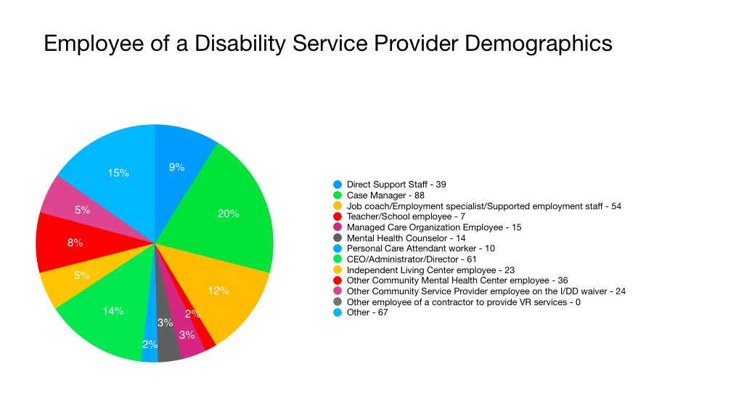

Slide 53
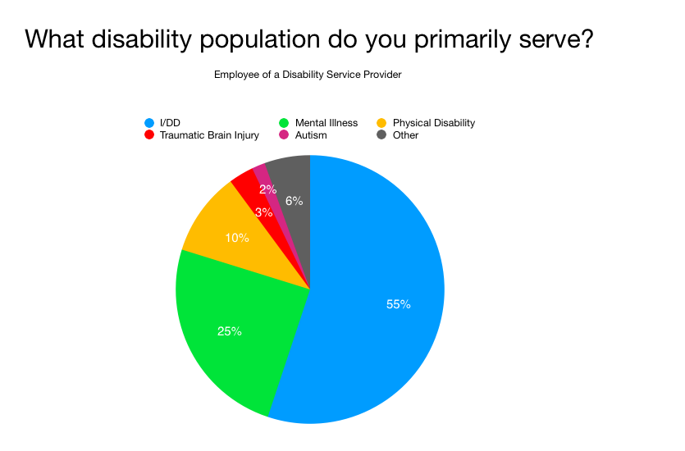

Slide 54
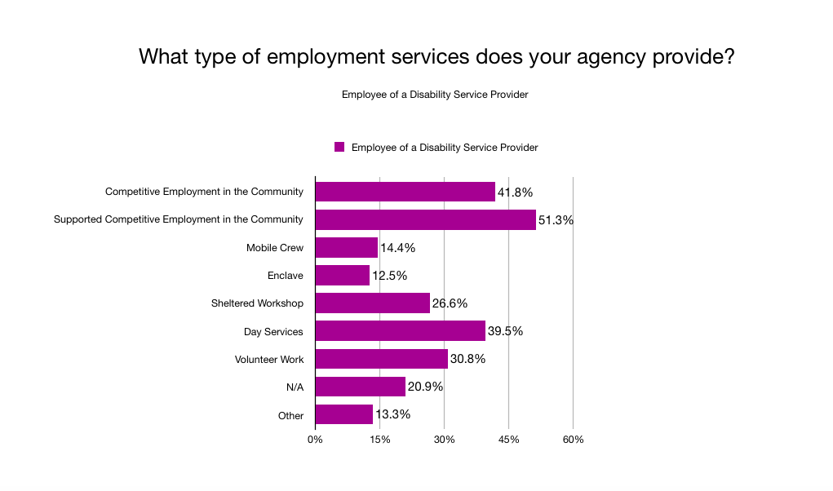

Slide 55
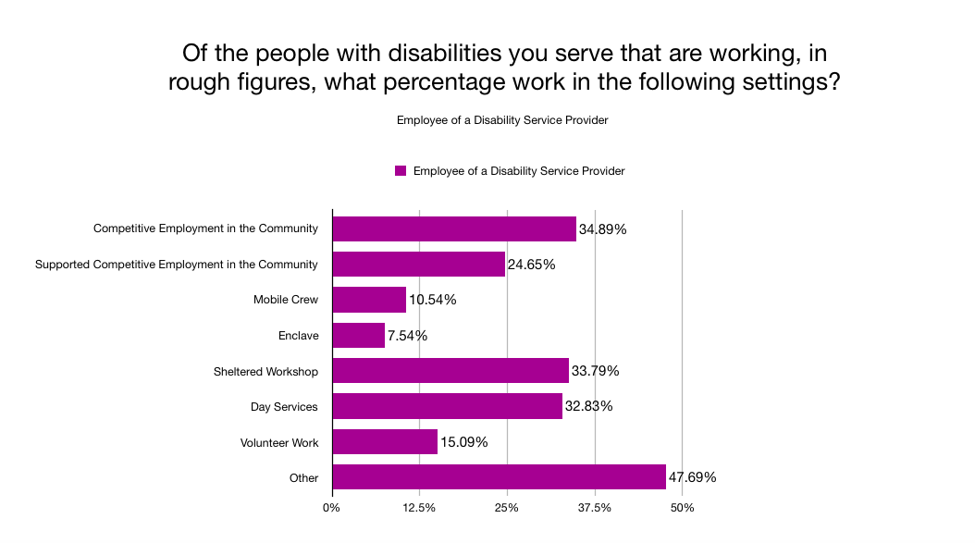

Slide 56
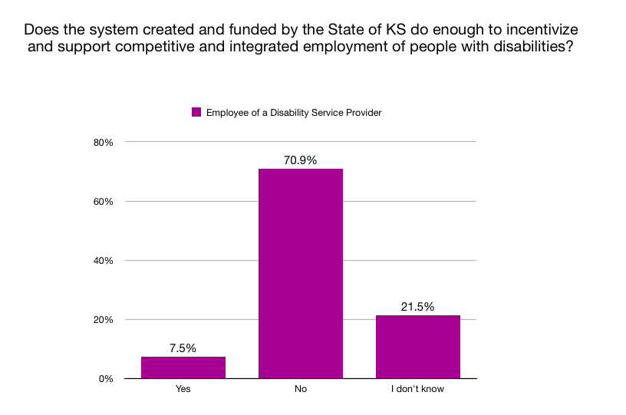

Slide 57
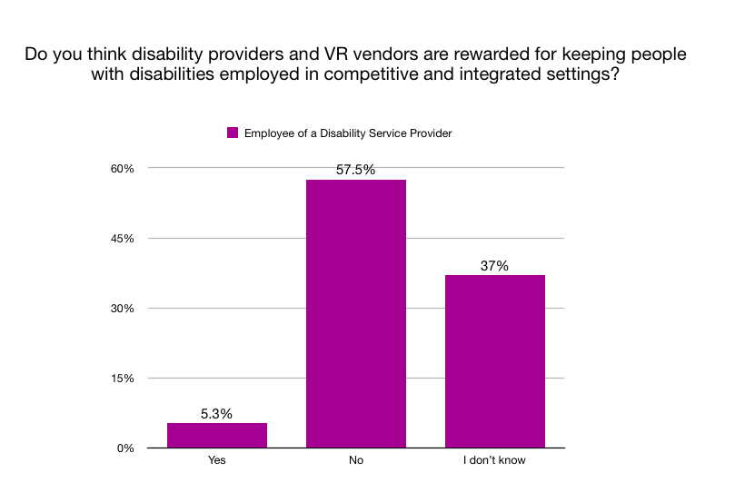

Slide 58
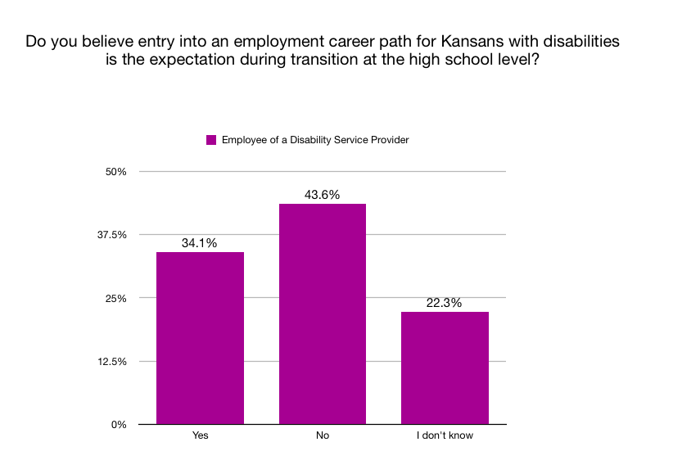

Slide 59
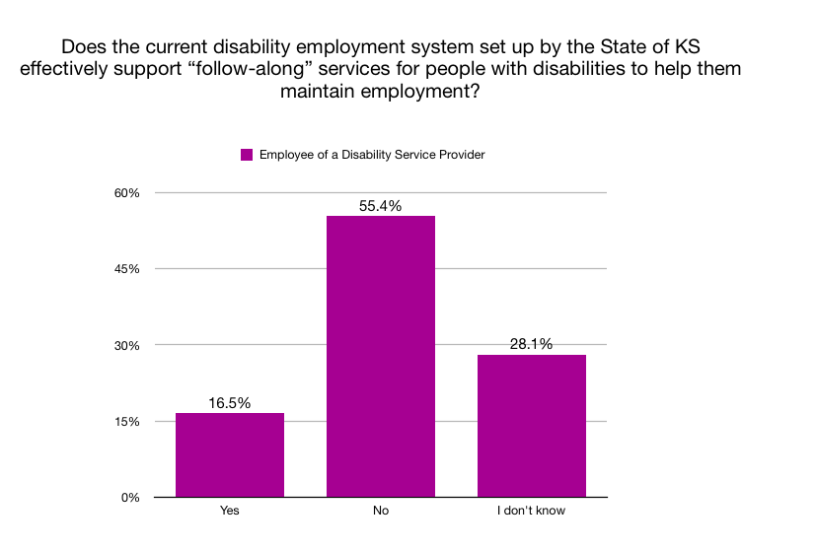

Slide 60
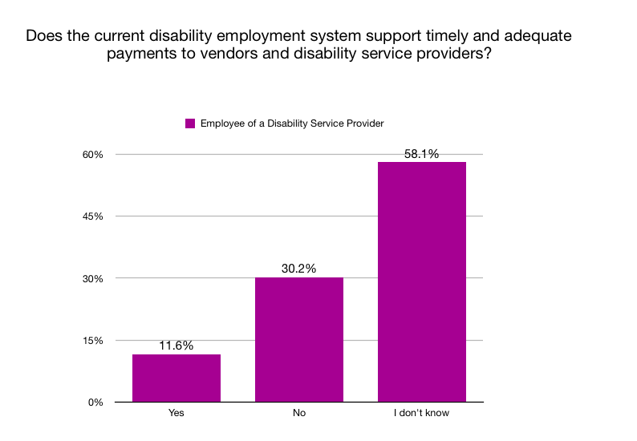

Slide 61
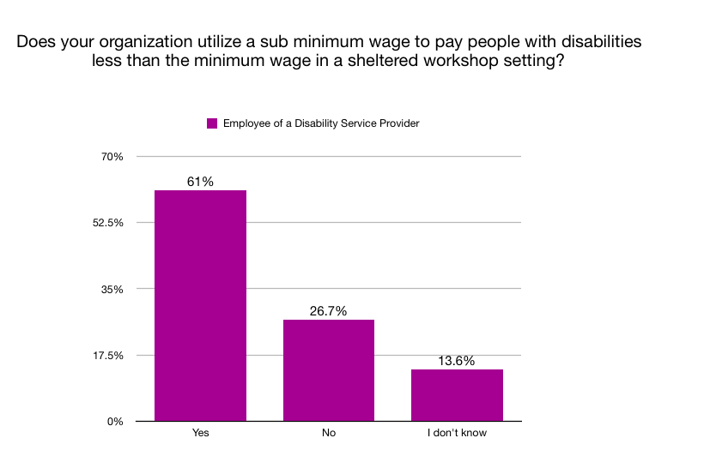

Slide 62
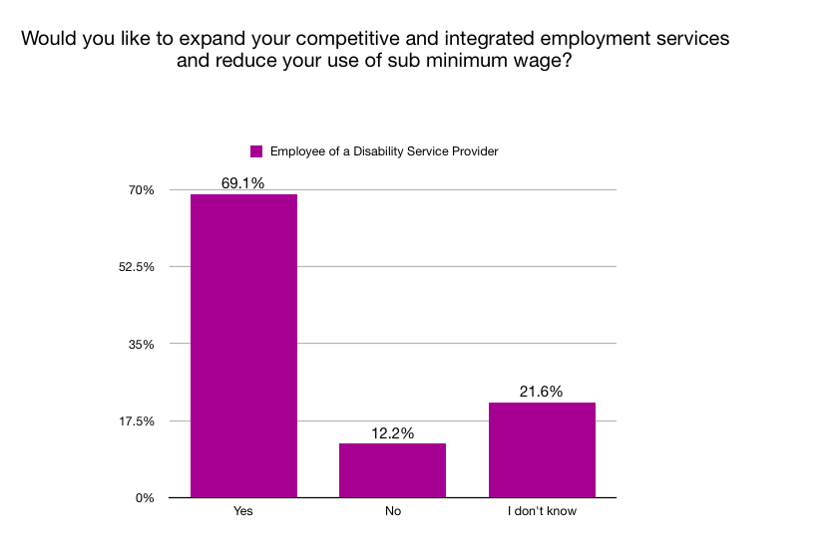

Slide 63
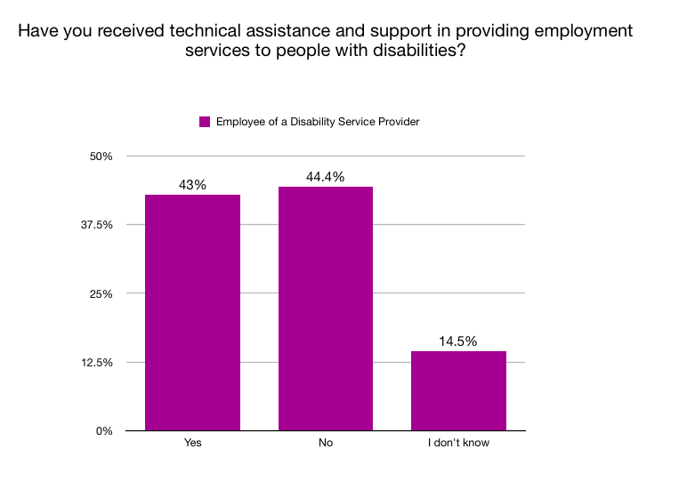

Slide 64
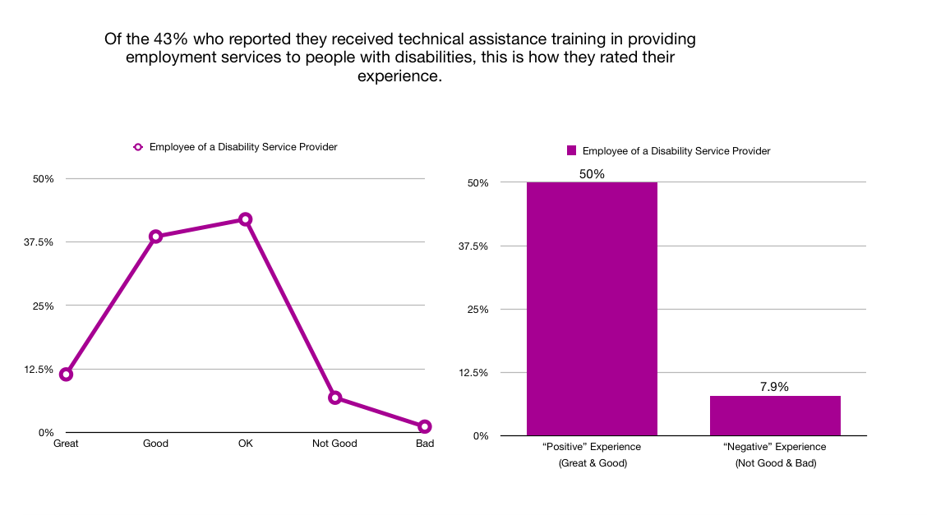

Slide 65
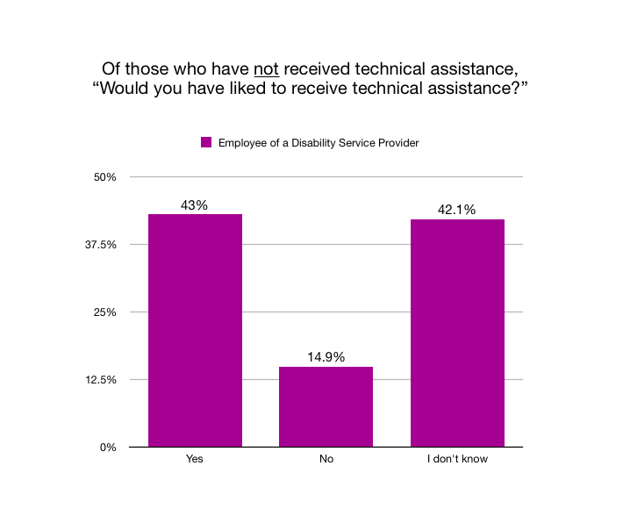

Slide 66
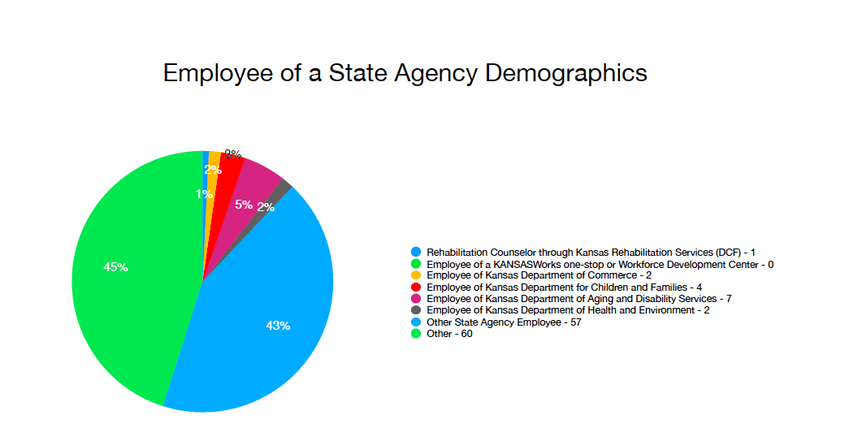

Slide 67
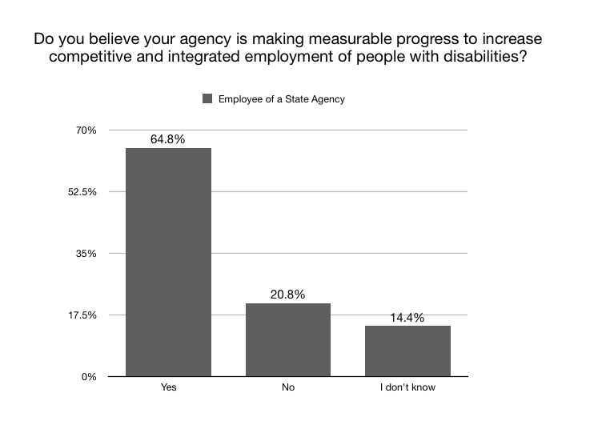

Slide 68
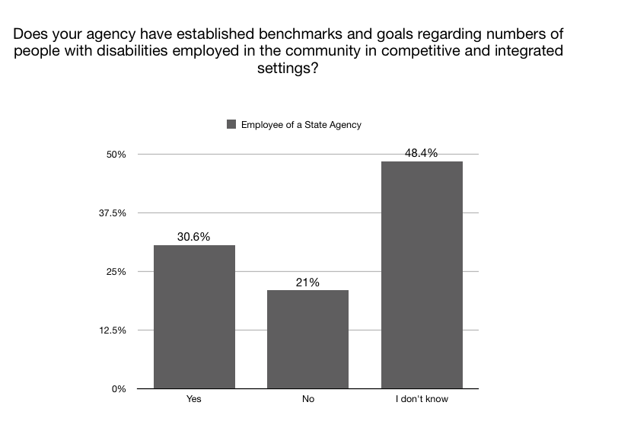

Slide 69
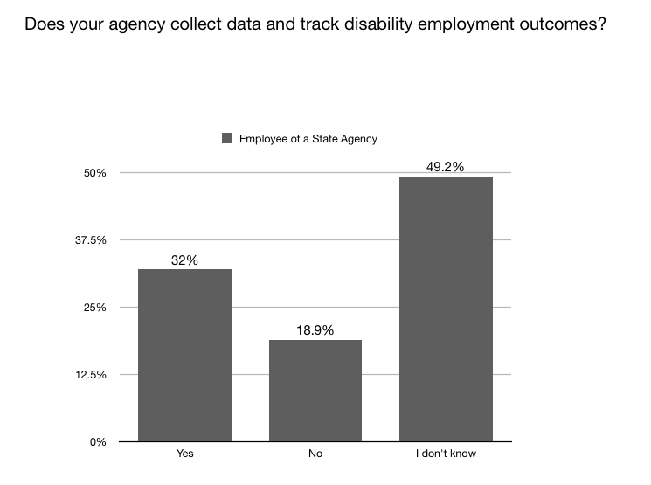

Slide 70
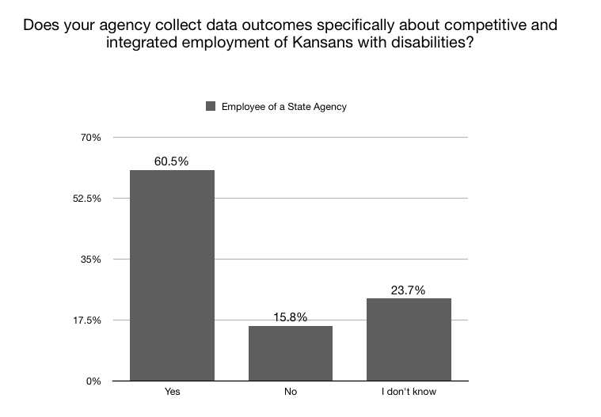

Slide 71
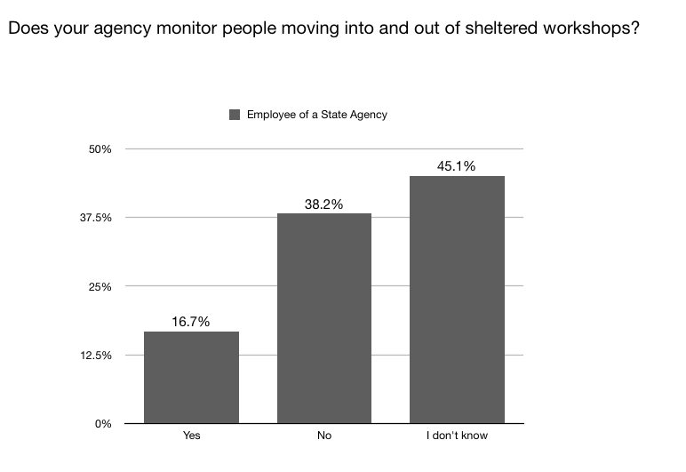

Slide 72
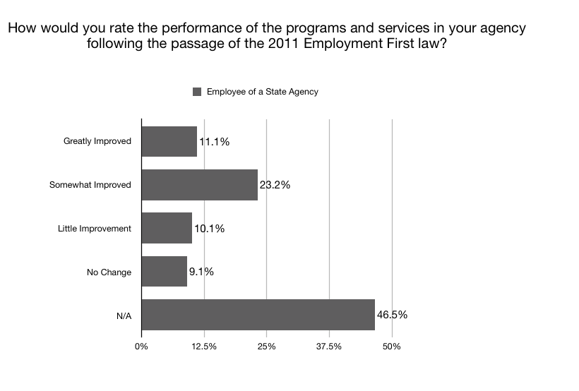

Slide 73
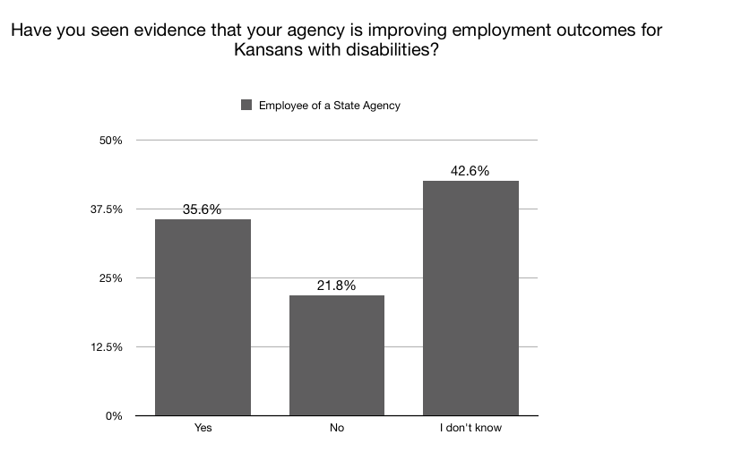

Slide 74
