Slide 1
Aetna The Search for Diverse Talent
Mary Lipscomb
November 2018

Slide 2
Agenda
Aetna Overview
Honoring the Power of the Human Spirit for People with Disabilities
Join Us To Help Transform Health
Opportunities & High Volume Hiring Locations
How You Can Help
How to Apply
Behavioral Interviewing Preparation
Q&A

Slide 3
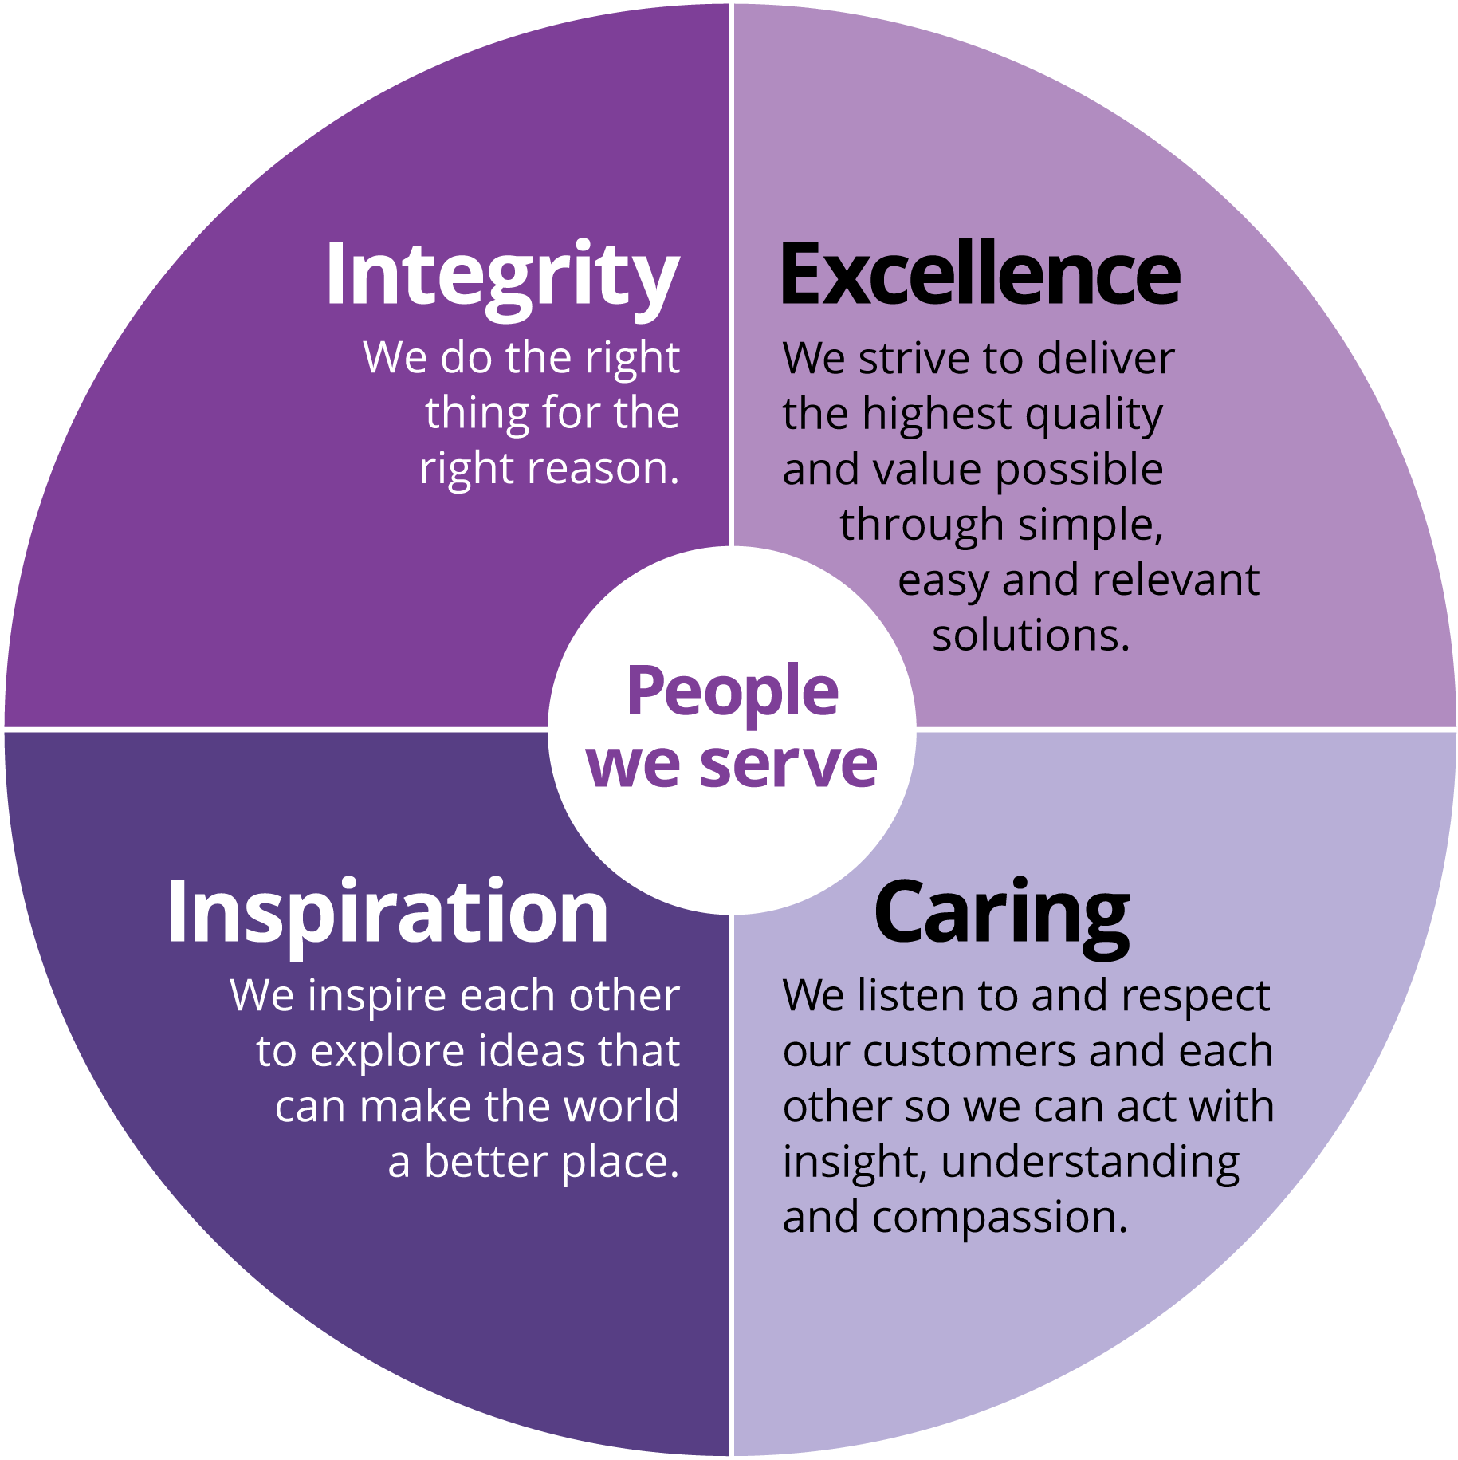
About Us
Fortune #43
Fortune Magazine’s Top 100 Companies
62 Billion
Dollar Organization
165 Years
Aetna was founded in 1853
50,000 +
Worldwide Employees
140 + Locations
Hartford, CT
Phoenix, AZ
Blue Bell, PA
New Albany, OH
Fresno, CA
Multiple locations in FL & TX
2018 Disability Awards
Mission
Building a healthier world
“You don’t join us, we join you”
Culture
Passionate about what we do
Strive to exceed customer’s expectations
Embrace technology and innovation
Invest in our employees
Bring positive change to our communities
Our Values

Slide 4
Video
Notes:
Honoring the Power of the Human Spirit for People with Disabilities https://www.youtube.com/watch?v=5soBTgHcWCA

Slide 5
Join us to help transform health
At Aetna:
We join our members in achieving their health ambitions in the communities where they live and work.
We are committed to building a workforce that is as diverse as those we serve, fostering culture where everyone is invited to bring their unique perspectives.
So what makes us different?
Tuition reimbursement and student loan payment programs
Employee Resource Groups that help exchange ideas, build community, and inspire
Wellness programs that promote mental, physical, and financial health
Commitment to provide reasonable accommodation to qualified employees
Exciting partnerships with companies like Apple®
Paid community service days
Employee benefits: https://www.aetnacareers.com/benefits

Slide 6
Opportunities

Slide 7
High Volume Hiring Locations

Slide 8
How can you help?
Outreach:
Share Aetna opportunities, our culture, what makes us different - with your networks!
Help us in driving diverse talent to our website
Encourage self-identification!
Local job fair events / meetings Aetna should attend
www.aetnacareers.com/diversity-inclusion

Slide 9
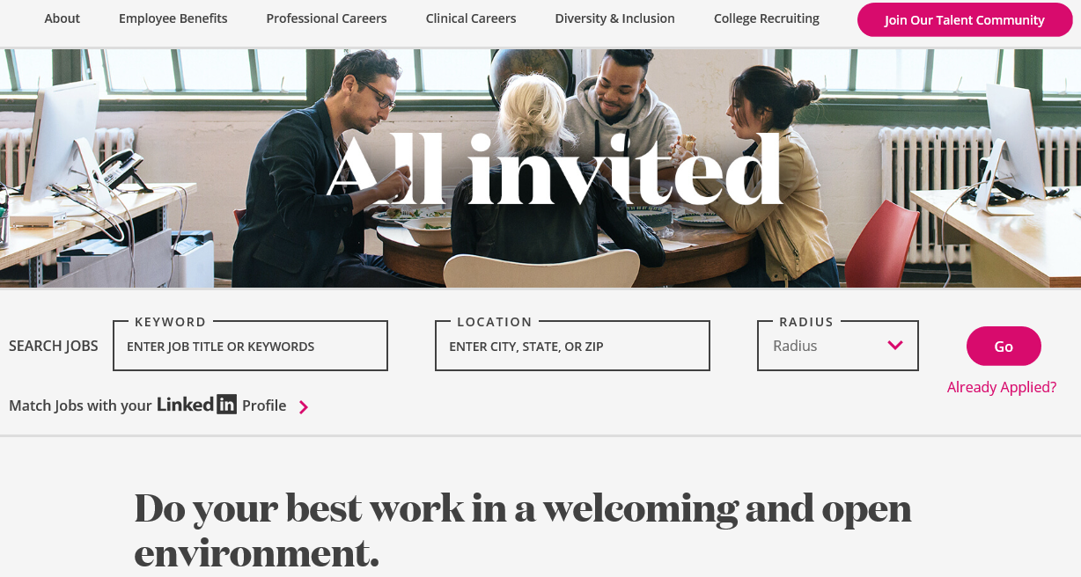
How to Apply
www.aetnacareers.com/diversity-inclusion
Notes:
Search by keyword, location, req#
Opportunity for you to self-identify as a IWD, Veteran, Military Spouse.
Encourage to self-identify!

Slide 10
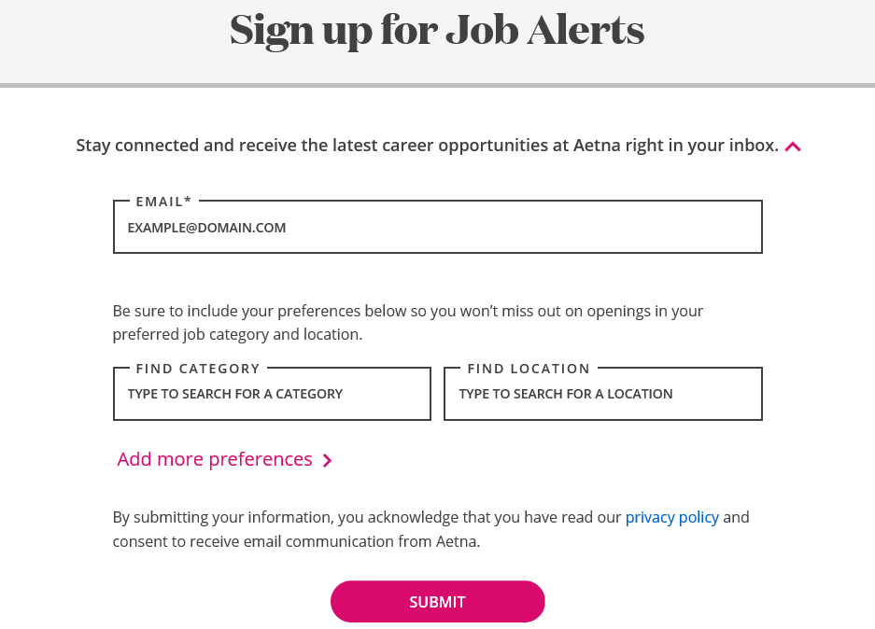
Job Alerts

Slide 11
Behavioral Interviewing
Interviewing technique based on:
Idea that previous actions and behavior are best predictors of future success
Questions related to competencies/skills required for job
Questions focused on past behaviors that demonstrate required skills
Traditional vs. Behavioral questions
Traditional Interview Questions (Hypothetical) | Behavioral Interview Questions (Specific)
How would you deal with an angry customer? | Give me a specific example of a time when you had to address an angry customer. What was the problem and how did you resolve it?
How would you work together on a project with more than two or three people? | Describe a recent situation where you had to work with several people to complete a task.
What do you do to meet deadlines? | Tell me about a time in the last 6 months when you had too much to do to meet your deadlines.
Notes:
Behavioral interviewing is widely used to predict future job performance based on a candidate’s past behavior.
The following tips can help you prepare for this type of interview.
Listen to the question carefully
Ensure you understand the question
Organize your answer
State your answer
Do not digress from your plan
Answer follow-up questions

Slide 12
Use the STAR technique to narrate an experience

Slide 13
Questions?

